Slide 1

SMART IRRIGATION SYSTEM USING IOT
BATCH NO: B11
SOWMYA.J (154G1A0584)
SAI SHARADA.G (154G1A0576)
SREEJA.L.S (154G1A0587)
WASEEM AKRAM.M (154G1A05B0)
Srinivasa Ramanujan Institute of Technology
Department of Computer Science & Engineering
Project Guide: Mr.Y.Ramesh M.Tech. Assistant Professor,CSE

Slide 2
Contents
Problem Definition
Literature Survey
Proposed Solution
Planning
Requirements
References

Slide 3
Problem Definition
Agricultural area receives power supply usually in non-peak hours; also frequent power cuts and low voltage supply creates a big problem to farmers.
If farmer fails to attend the irrigation, there is a chance of wastage of water and electricity. Also, excess watering leads to soil damage.

Slide 4
Literature Survey Journal - I
Title: SMART IRRIGATION SYSTEM BASED ON SOIL MOISTURE USING IOT
Authors: S Nalini Durga, M Ramakrishna
Published In: (IRJET) June 2018 [1]

Slide 5
Abstract
This paper focuses primarily on reducing the wastage of water and minimizing the manual labor on field for irrigation so that you can saving time, cash and power of the farmer.
The system has three major parts; humidity sensing part, control section and the output section. The soil humidity was detected using soil sensor.
The control unit was achieved using arduino. The output is irrigation system which is controlled by the control unit by switching it on and off depending on the soil moisture contents.
The real time conditions sensed data is send to the cloud server for storing and decision making and controlling actions.

Slide 6
Journal - II
Title: SMART IRRIGATION SYSTEM USING IOT AND RASPBERRY PI
Authors: Ms. Swapnali B.Pawar, Prof. Priti Rajput, Prof. Asif Shaikh
Published In: (IRJET) August 2018 [2]

Slide 7
Abstract
Today automation is one of the important role in human life. The system is not only provides comfort but also reduce energy, efficiency and time saving.
Whenever there is a change in temperature, humidity and current status of rain of the surroundings these sensors senses the change in temperature and humidity and gives an interrupt signal to the raspberry pi.
The system can be used to control the water motor automatically and can also monitor the growth of plant by using webcam. We can watch live streaming of farm on mobile phone using suitable application by using Wi-Fi network.

Slide 8
Conference Paper-I
Title: MOBILE INTEGRATED SMART IRRIGATION MANAGEMENT AND MONITORING SYSTEM USING IOT
Authors: Vaishali S, Suraj S, Vignesh G, Dhivya S and Udhayakumar S
Published In: (IEEE) 2017 [3]

Slide 9
Abstract
This is a Mobile Integrated and smart irrigation system using IOT based on application controlled monitoring system. The idea is to focus on parameters such as temperature and soil moisture.
The main objective of this project is to control the water supply and monitor the plants through a Smartphone.
The smart phone is connected to raspberry pi through Bluetooth. The motor is controlled by the smart phone by the values ON and OFF.

Slide 10
Conference Paper-II
Title: IOT BASED CONTROL AND AUTOMATION OF SMART IRRIGATION SYSTEM
Authors: M Monica ; B. Yeshika ; G.S Abhishek ; H.A Sanjay ; Sankar Dasiga
Published In: 2017 (IEEE) [4]

Slide 11
Abstract
Our system is able to deliver optimal water to the plants based on moisture, light and temperature levels which are obtained through sensors.
The farmer will be able to monitor the parameters through the mobile app which is integrated with cloud storage.
Integration of the GSM module to the Ardino helps us achieve real time updates on the conditions of the plot of land. Any malfunction in the hardware will be sent via message.
We use a generic application to turn on and off the motor, this is a safety unit in case any malfunction occurs during the process of automation. After pairing the Bluetooth of the system to our smart phone, the motor can be turned on and off according to convenience.

Slide 12
Proposed solution
In proposed solution, Smart Irrigation System uses Raspberry pi , where it monitors the amount of moisture content in the soil.
A threshold value of soil moisture is set and can be varied. In case the soil moisture of the soil deviates from the specified range, the notification is sent to the user to ON/OFF the motor using gsm module.
Electricity supply can be monitored using electricity sensor.

Slide 13
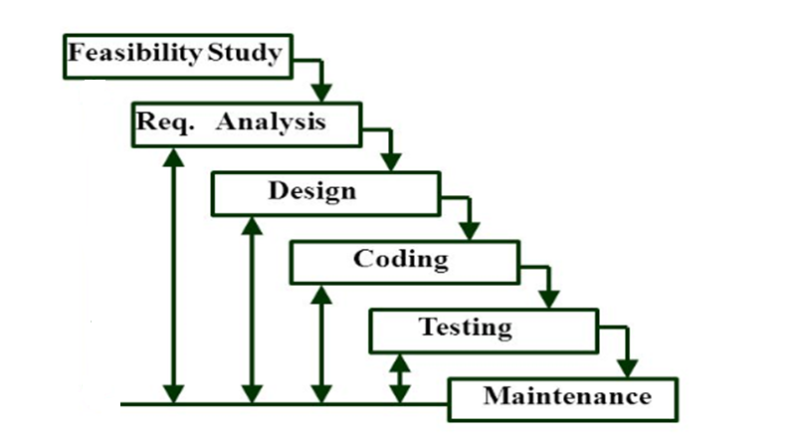
Planning Model
Iterative Waterfall Model:

Slide 14
Iterative Waterfall Model
This model provides feedback paths from every phase to its preceding phases.
But, there is no feedback path to the stage – feasibility study, because once a project has been taken, does not give up the project easily.
When errors are detected at some later phase the feedback paths allow the phase to be reworked in which errors are committed and these changes are reflected in the later phases.
Results are obtained early and periodically. Testing and debugging during smaller iteration is easy.

Slide 15
Planning
Time Schedule:
Week - 1 : Gathering Requirements
Week - 2 : Designing
Week - 3 : Coding
Week - 4 : Testing and Implementation
Week - 5 : Maintenance

Slide 16
Abstract review comments
To check the power supply in the field, electricity sensor is added which detects any power loss and updates the user through GSM module.

Slide 17

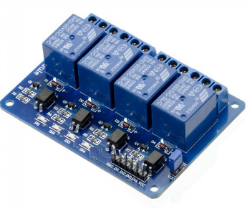
Requirements
SOIL MOISTURE SENSOR
Soil Moisture Sensor is used to measure the moisture
content in the soil.
We can set the desired threshold value.
It continuously monitors the moisture content
It is connected to raspberry pi.
RELAY MODULE
Relay module is used to turn on and off the pump
according to the moisture level of the soil.
It is controlled by interfacing it to the raspberry pi.

Slide 18
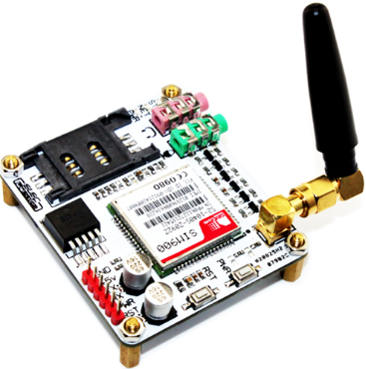
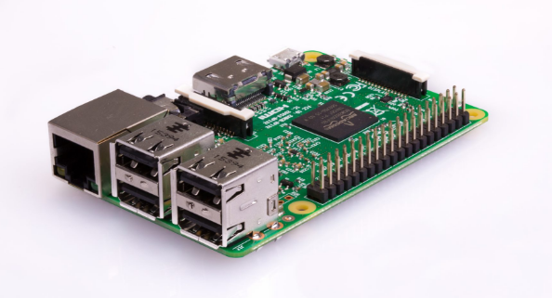
Continued……
GSM MODULE
It is very tiny and can fit anywhere.
It is used to transmit SMS, Voice information with
low power consumption.
It accepts any GSM network operator’s SIM.
it can act just like the mobile phone with it’s own unique phone number.
RASPBERRY PI 3
It is a small sized single board computer.
It has GPIO(General Purpose Input Output) pins
to which we can connect the sensors.

Slide 19
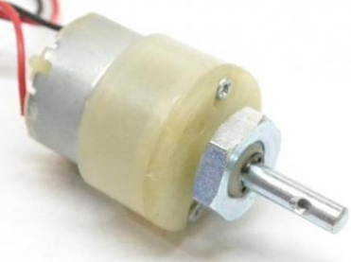
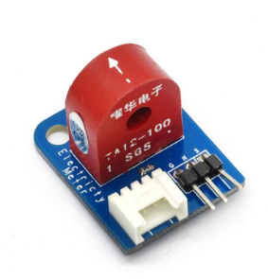
Continued…
DC MOTOR
Dc motor is a machine that converts
the electrical energy to mechanical energy.
ELECTICITY SENSOR
It is used to detect the flow of electricity.

Slide 20
References:
[1] S Nalini Durga, M Ramakrishna
“SMART IRRIGATION SYSTEM BASED ON SOIL MOISTURE USING IOT”
volume: 05 page no: 2003-2007 (IRJET) june-2018
[2] Ms. Swapnali B.Pawar, Prof. Priti Rajput, Prof. Asif Shaikh
“SMART IRRIGATION SYSTEM USING IOT AND RASPBERRY PI”
volume: 05 page no: 1163-1166 August 2018 (IRJET)
[3] Vaishali S, Suraj S, Vignesh G, Dhivya S and Udhayakumar S
“MOBILE INTEGRATED SMART IRRIGATION MANAGEMENT AND MONITORING SYSTEM USING IOT” (IEEE)
page no: 2164-2167 , 2017
[4] M Monica ; B. Yeshika ; G.S Abhishek ; H.A Sanjay ; Sankar Dasiga
“IOT BASED CONTROL AND AUTOMATION OF SMART IRRIGATION SYSTEM”(IEEE)
page no: 601-607, 2017

Slide 21
Thank you
Queries
?

